Slide 1





Non-patient File Sharing (NPFS) https://profiles.ihe.net/ITI/NPFS/
Alessandro Pinton
Arsenàl.IT

Slide 2
The Needs
Non-patient File Sharing (NPFS) defines how to enable the sharing of non-patient files.
Those files can be created, consumed and updated by many different systems.
Any file type can be shared using this profile; however, specific guidance is given for three types of files:
Workflow Definitions
Privacy Domain Policies
Stylesheets

Slide 3
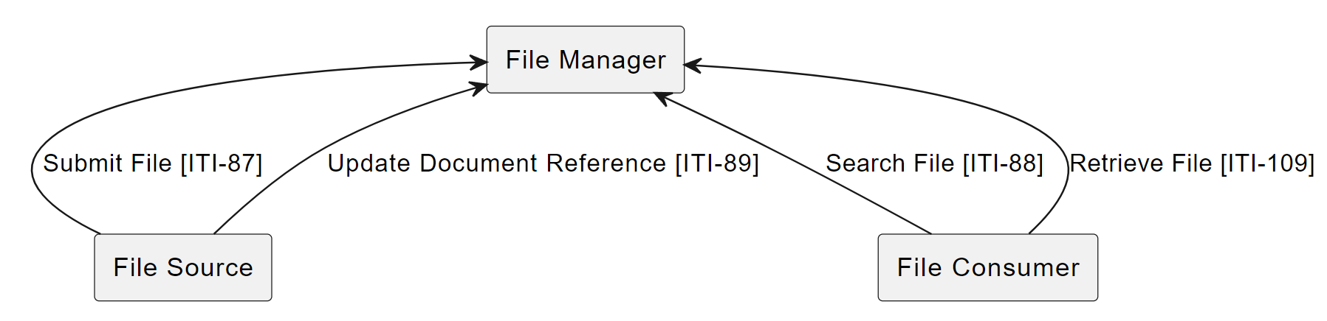
Actors

Slide 4
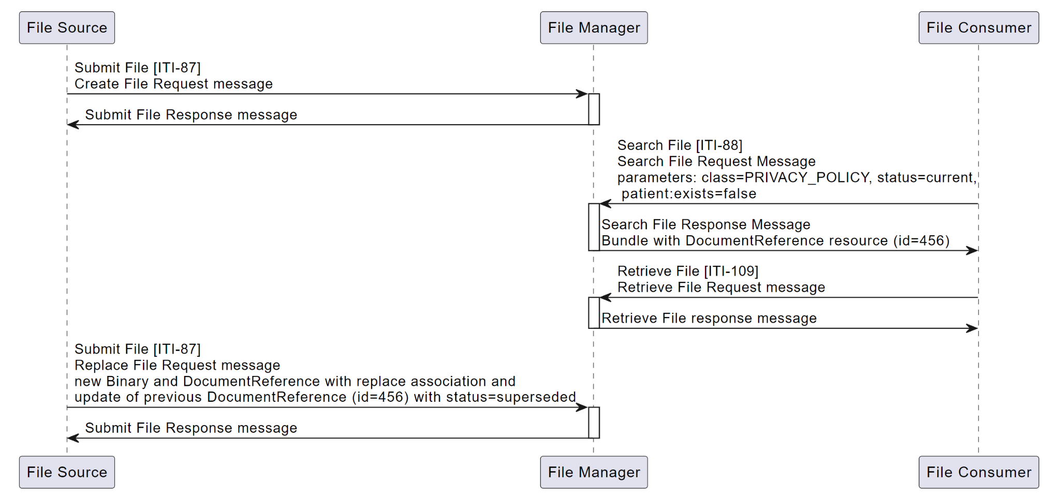
Use-case: Privacy Domain Policies Process Flow

Slide 5
Conversion
NPFS has been converted to Implementation Guide with some significant changes from Revision 2.1 (PDF):
Replaced reference to MHD [ITI-68] Retrieve Document transaction width [ITI-109] Retrieve File transaction
Include CapabilityStatements for the actors
Add defined AuditEvent requirements leveraging BALP when grouped with ATNA
Integrated CP 1139

Slide 6
Questions
The Non-patient File Sharing (NPFS) IG
https://profiles.ihe.net/ITI/NPFS/
All IHE IT-Infrastructure publications
https://profiles.ihe.net/ITI
Discussions on IHE use of FHIR
https://chat.fhir.org/#narrow/stream/179223-ihe

